Slide 1
Car Sales Analysis
By Shruti Biswas

Slide 2
Data Analysis
This dataset was collected from car sale advertisements between years 1953 to 2016 for study/practice purposes
Duplicate records were deleted
The missing values of engine volume were replaced with the mean
Preprocessing has been done

Slide 3
Observations / Conclusions
In this dataset We have total 9576 observations after removing duplicate records.
We observe that out of total cars sold, majority of the cars sold by "Volkswagen", "Mercedes-Benz" and "BMW" brand.
"Sedan", "Crossover" and "Hatch" body types cars are the highest sold cars.
"Front" drive type segment cars are the highest sold cars, because most of the cars of this segment falls in lower price range.
80% of total cars sold in the price range of 200 to 20000 with body type as "Sedan", drive type as "Front" and engine type as "Petrol", because the middle class families preferred low price cars with Sedan body and Petrol engine type.
"Mercedes-Benz" is the leading brand in higher price segment cars.
Majority of the higher price range cars sold with body type as "Crossover", drive type as "Full" and engine type as "Diesel".
All body segment of cars have more average price for "Full" drive type cars compare to other drive type cars.
Approx. 55% of total cars sold have engine volume in the range of 1.5 CC to 2.5 CC.
We have also observed that lower price segment car has higher mileage and higher price segment car has lower mileage.
Majority of the cars with production year 2008 or later were registered in Ukraine sold in price of 50000 or lower.
Production year 2008 and 2012 cars are the highest sold cars.

Slide 4
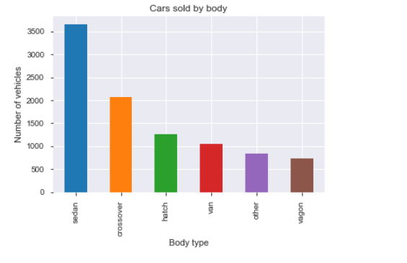
Cars Sales Statistic By Body Type

Slide 5
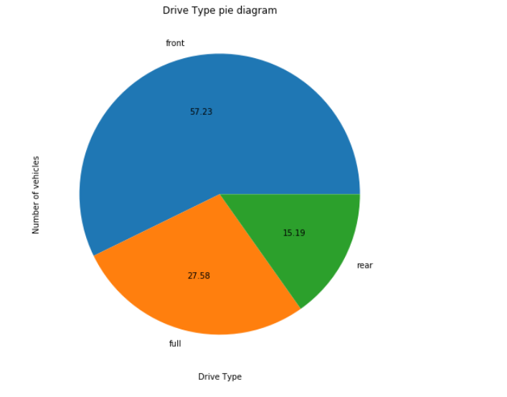
Distribution of Cars based on Drive Type

Slide 6
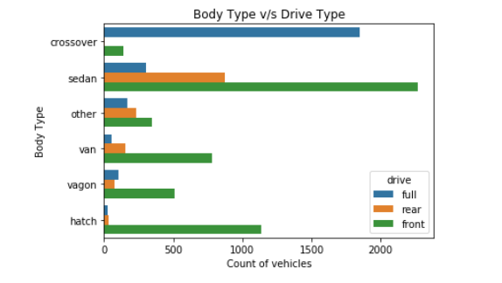
Distribution of cars based on Body Type and Drive Type

Slide 7
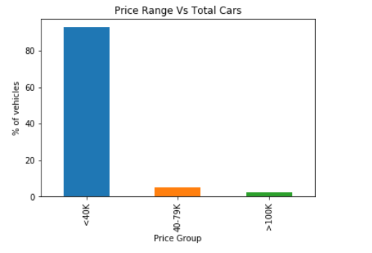
Cars Distribution based on Price Range

Slide 8
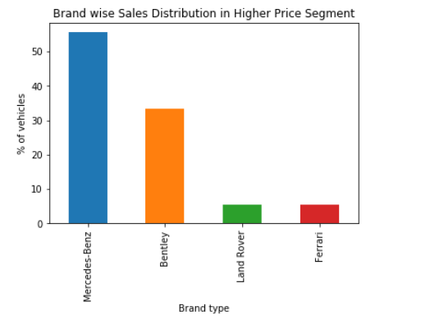
Brand wise sales distribution

Slide 9
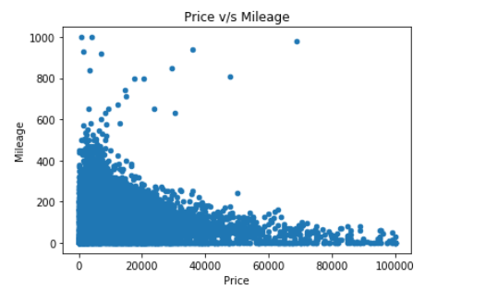
Correlation between Price and Mileage

Slide 10
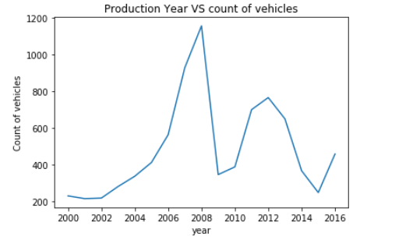
Number of cars produced per Year

Slide 11
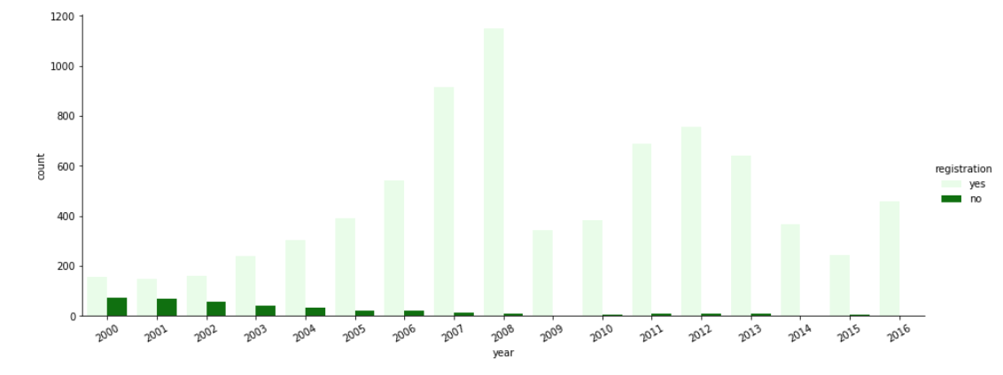
Correlation between car produced year and Registration

Slide 12
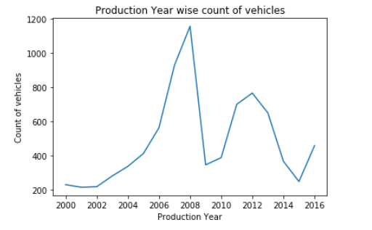
Which production year of cars sold the most ?

